Slide 1
CSC 302
Distributed Systems

Slide 2

MODULE 1
Topics for Module 1
What is a Distributed System?
Why Distributed Systems?
Examples of Distributed Systems.
Distributed Systems Requirements.
Transparency in Distributed Systems

Slide 3

MODULE 1: Distributed Systems
Distributed Systems:
A distributed system is a network of autonomous computer systems that are physically separated but interconnected through a centralized computer network. These systems collaborate by sharing resources, files, and tasks assigned to them.

Slide 4
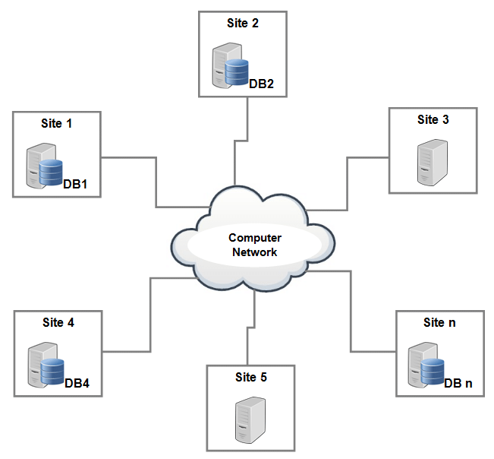
MODULE 1: Distributed Systems
Distributed Systems

Slide 5


MODULE 1: Distributed Systems
Key aspect of Distributed Systems
Autonomous Computers: In a distributed system, each computer (or node) operates independently. These nodes can be geographically dispersed but communicate over the network.
Resource Sharing: Distributed systems allow for the use of hardware, software, and data from anywhere within the system. This flexibility enables efficient resource utilization.
Centralized Network: The network acts as a bridge, connecting the autonomous systems. It facilitates communication, coordination, and data exchange among the nodes.

Slide 6
MODULE 1: Distributed Systems
Better Availability:
Unlike monolithic systems that rely on a single server, distributed systems distribute their workload across multiple nodes. This redundancy ensures that even if one server fails, the system remains operational. Modern operations practices, such as infrastructure as code, containers, and serverless, further reduce downtime and recovery time.
Why Distributed Systems:
distributed systems enable better availability, scalability, resource accessibility, and efficient utilization of computing resources.
Scalability:
Distributed systems can easily scale by adding more nodes. As the user base grows, additional servers can be seamlessly incorporated to handle increased demand.

Slide 7
MODULE 1: Distributed Systems
Resource Accessibility:
Distributed systems make resources easily accessible. They hide the fact that these resources are distributed across a network, providing a unified view for users and applications.
Why Distributed Systems:
distributed systems enable better availability, scalability, resource accessibility, and efficient utilization of computing resources.
Efficiency:
While building distributed systems is complex, they can achieve great performance and efficiency. Single-system designs can be efficient, but distributed systems offer fault tolerance and scalability that monolithic systems lack.
Machine Learning and AI:
Distributed computing is essential for machine learning and artificial intelligence applications, where massive computational power is required.

Slide 8
MODULE 1: Distributed Systems
World Wide Web (WWW): Web pages are stored on numerous servers worldwide, allowing users to access information from different locations.
Cloud Computing Platforms: Services like AWS, Google Cloud, and Azure use a network of computers to provide scalable computing resources to users.
Peer-to-Peer Networks (P2P): BitTorrent is an example where files are shared directly among users without a central server.
Distributed Databases: These databases store data across multiple machines, ensuring redundancy and improved performance e.g. Amazon DynamoDB, Microsoft Azure Cosmos DB, Apache Cassandra
Examples of Distributed Systems:

Slide 9
MODULE 1: Distributed Systems
Scalability:
Definition: The system should be able to handle an increasing amount of load by adding more resources or nodes.
Considerations: Horizontal scalability (adding more machines) is often preferred. Design algorithms and data structures that can scale linearly with the number of nodes.
Distributed Systems Requirements:
Designing and implementing distributed systems requires careful consideration of various requirements to ensure the system's effectiveness, reliability, and scalability.
Fault Tolerance:
Definition: The system should continue to operate and provide services even in the presence of hardware or software failures.
Considerations: Implement redundancy, replication, and recovery mechanisms. Use techniques like data mirroring, checkpointing, and distributed consensus algorithms.

Slide 10
MODULE 1: Distributed Systems
Consistency:
Definition: All nodes in the distributed system should have a consistent view of the data.
Considerations: Choose an appropriate consistency model based on the application requirements. Options include strong consistency, eventual consistency, and causal consistency.
Distributed Systems Requirements:
Designing and implementing distributed systems requires careful consideration of various requirements to ensure the system's effectiveness, reliability, and scalability.
Availability:
Definition: The system should be available and responsive, even in the face of failures or partial outages.
Considerations: Design for redundancy, implement load balancing, and have mechanisms for detecting and handling failures. Use techniques like replication and sharding to distribute load.

Slide 11
MODULE 1: Distributed Systems
Partition Tolerance:
Definition: The system should continue to operate despite network partitions or communication failures between nodes.
Considerations: Implement distributed consensus protocols like Paxos or Raft to ensure consistent behaviour during network partitions.
Concurrency Control:
Definition: Ensure proper management of concurrent access to shared resources to avoid data corruption or inconsistency.
Considerations: Use techniques like locking, optimistic concurrency control, and distributed transactions to manage concurrency.
Distributed Systems Requirements:
Designing and implementing distributed systems requires careful consideration of various requirements to ensure the system's effectiveness, reliability, and scalability.

Slide 12
MODULE 1: Distributed Systems
Isolation:
Definition: Transactions should be isolated from each other to prevent interference and maintain data integrity.
Considerations: Implement isolation levels in database transactions. Consider the trade-offs between consistency and performance.
Security:
Definition: Ensure the confidentiality, integrity, and availability of data in the distributed system.
Considerations: Implement secure communication using encryption, enforce access controls, and regularly audit and monitor the system for potential security vulnerabilities.
Distributed Systems Requirements:
Designing and implementing distributed systems requires careful consideration of various requirements to ensure the system's effectiveness, reliability, and scalability.

Slide 13
MODULE 1: Distributed Systems
Performance:
Definition: The system should deliver high performance and low latency.
Considerations: Optimize algorithms and data structures for distributed environments. Use caching, load balancing, and efficient communication protocols to enhance performance.
Interoperability:
Definition: Different components and nodes within the distributed system should be able to communicate and work together seamlessly.
Considerations: Use standard communication protocols and data formats. Ensure compatibility between different versions of system components.
Distributed Systems Requirements:
Designing and implementing distributed systems requires careful consideration of various requirements to ensure the system's effectiveness, reliability, and scalability.

Slide 14
MODULE 1: Distributed Systems
Monitoring and Logging:
Definition: Implement mechanisms for monitoring the health, performance, and behavior of the distributed system.
Considerations: Use tools like Prometheus, Grafana, ELK stack for logging, and create dashboards for real-time monitoring and diagnostics.
Ease of Management:
Definition: The system should be easy to deploy, configure, and manage.
Considerations: Provide tools for system administrators, implement automation for deployment and scaling, and offer comprehensive documentation.
Distributed Systems Requirements:
Designing and implementing distributed systems requires careful consideration of various requirements to ensure the system's effectiveness, reliability, and scalability.

Slide 15
MODULE 1: Distributed Systems
Adaptability:
Definition: The system should be adaptable to changes in requirements, workload, or environment.
Considerations: Implement dynamic scaling, configuration management, and make components loosely coupled to facilitate changes.
Distributed Systems Requirements:
Designing and implementing distributed systems requires careful consideration of various requirements to ensure the system's effectiveness, reliability, and scalability.

